Slide 1



$$η$$
$$ϕ$$

Slide 2
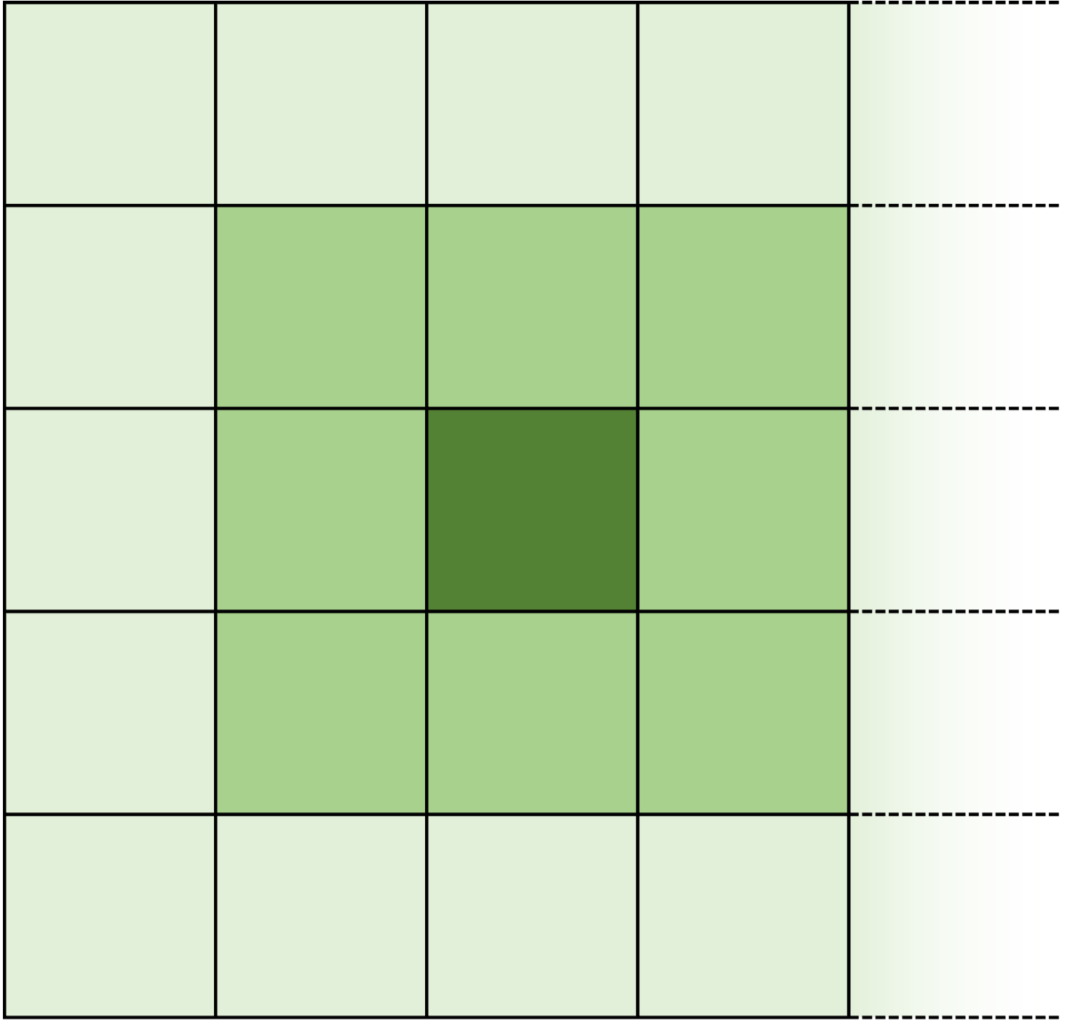


HCAL
$$η$$
$$ϕ$$

Slide 3


$$η$$
$$ϕ$$

Slide 4


ΔR = 0.3
$$η$$
$$ϕ$$

Slide 5


$$π^{±}$$
ΔR = 0.3
$$π^{±}$$
$$η$$
$$ϕ$$

Slide 6
ΔR = 0.3
$$η$$
$$ϕ$$

Slide 7

$$e^{±}$$
$$η$$
$$ϕ$$

